Slide 1

NETFLIX MOVIES AND TV SHOWS DATA ANALYSIS
2010030002 ABDUL KADIR KHAN
2010030165 SYED RESHMA BANU
2010030544 SRAVANI NAIDU

Slide 2
TABLE OF CONTEXT
Title
Table of context
Research area
Literature survey
Project objective problems
Motivation
Data set
Type of analysis
Conclusion
Reference

Slide 3
INTRODUCTION
Video Streaming and broadband connections help users around the globe download and watch large video files from the comfort of their homes. Taking advantage of this technology, the company Netflix launched a video streaming website on 2008 where users could watch the most recent Television episodes or other genres.

Slide 4
RESEARCH AREA
EDA(exploratory data analysis) will explore the Netflix dataset through visualizations
NETFLIX MOVIES AND TV SHOWS DATA ANALYSIS
Python and tableau

Slide 5
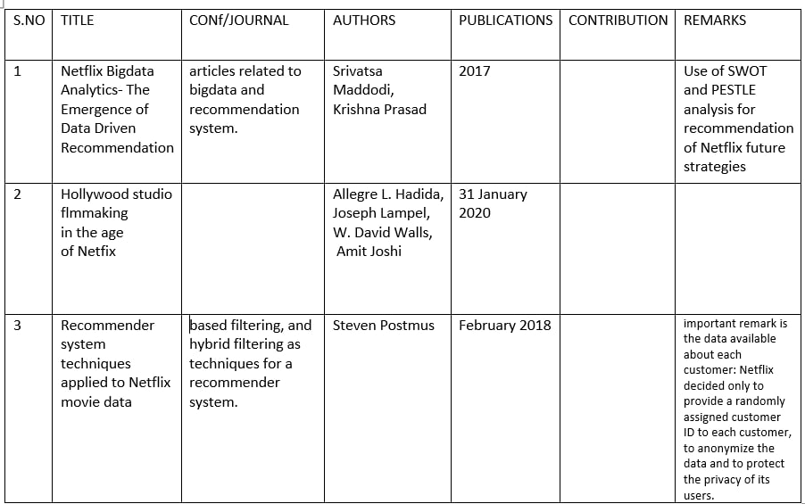
LITERATURE SURVEY

Slide 6
PROBLEM OBJECTIVES
Netflix is a popular entertainment service used by people around the world. This EDA will explore the Netflix dataset through visualizations and graphs using python libraries, matplotlib, and seaborn.
In this we are displays the data of dataset of movies and tv shows rating of the Netflix

Slide 7
MOTIVATION
Netflix is the largest online movie and TV show streaming service on the planet
In this project to analysis the how many people are watching what type of genres most in the Netflix
in this project we took the percentage of people who are watching Netflix
In this we analysis the rating of tv shows and rating in the Netflix

Slide 8
DATA SET
Netflix is one of the most popular media and video streaming platforms. They have over 8000 movies or tv shows available on their platform
We have taken Netflix_titles dataset from Kaggle
This dataset contains 12 features and in this data set have information about the tv shows and movies
This tabular dataset consists of listings of all the movies and tv shows available on Netflix, along with details such as - cast, directors, ratings, release year, duration, etc.

Slide 9
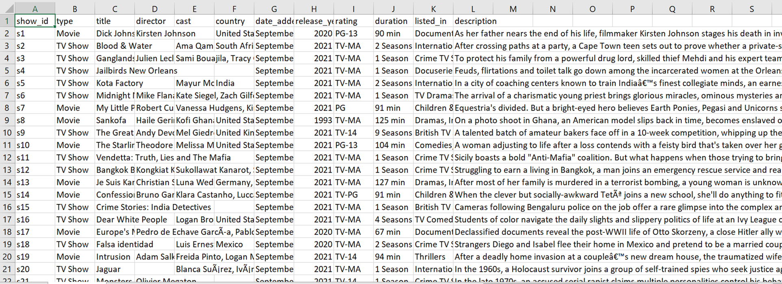

Slide 10
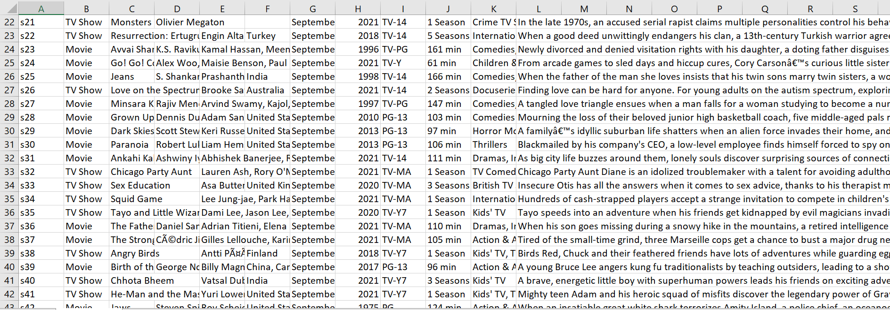

Slide 11
WHAT TYPE OF ANALYSIS
PYTHON
DATA VISUALIZATION

Slide 12
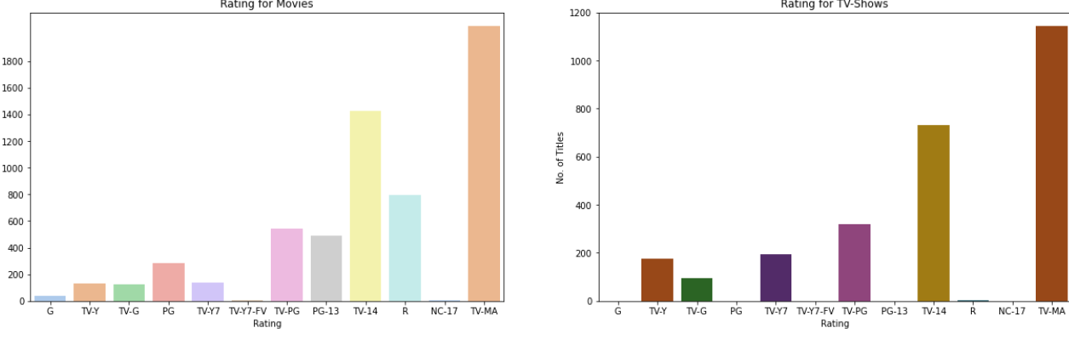
VISUALIZATION

Slide 13
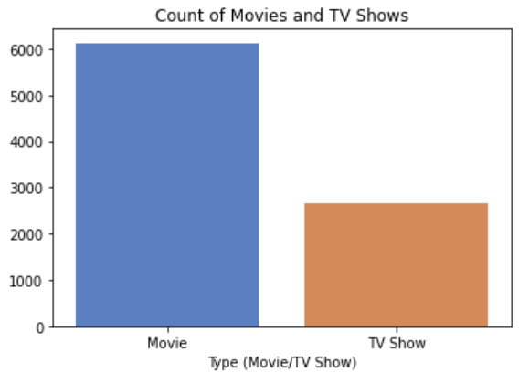
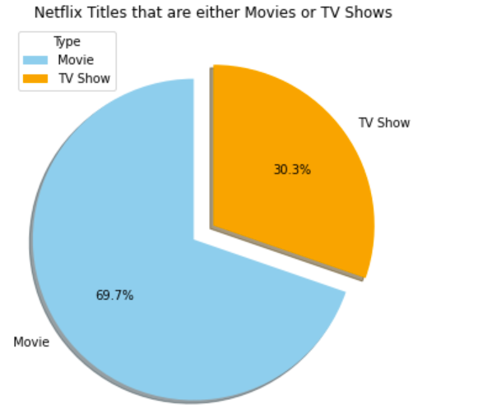

Slide 14
CONCLUSION
IN THIS PROJECT WE DECIDED TO ANALYSIS THE DATA SET AND COLLECTED THE DATA WITH MOST WATCHED THE MOVIE AND TV SHOWS IN NETFLIX WITH THE RATING WITH THE DATA VISUALIZATION TECHNIQUES.

Slide 15
REFERENCE
https://en.wikipedia.org/wiki/Netflix
https://vwo.com/blog/deliver-personalized-recommendations-theamazon-netflix-way.
https://medium.com/analytics-vidhya/netflix-movies-and-tvshows-exploratory-data-analysis-eda-and-visualization-using-python-80753fcfcf7

Slide 16
SUGGESTIONS

Slide 17
THANK YOU

